Slide 1


HAPPY CLUB
WELCOMES YOU

Slide 2

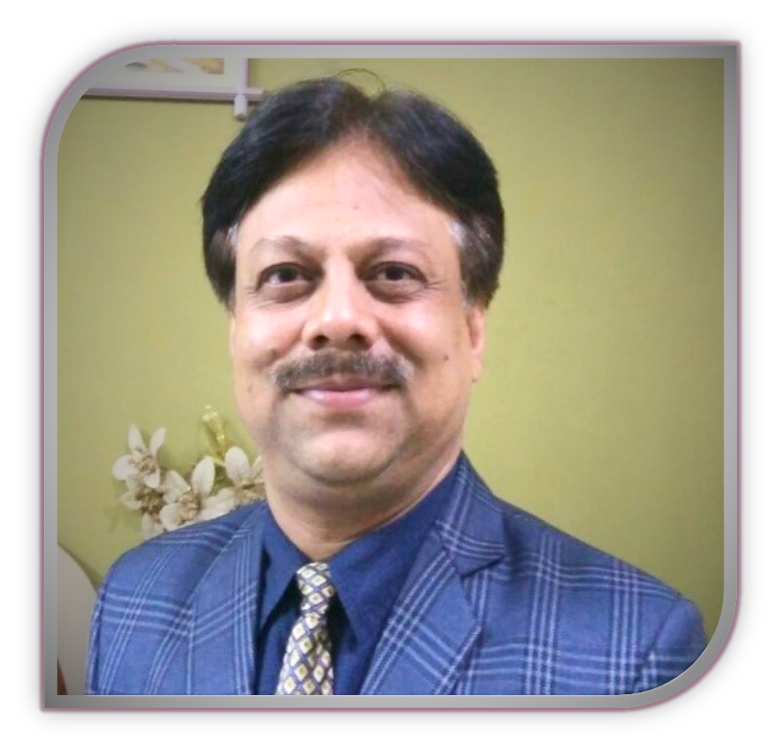
PATRON IN CHIEF
Dr. SHAILENDRA JAIN
(DIRECTOR, SLIET)

Slide 3
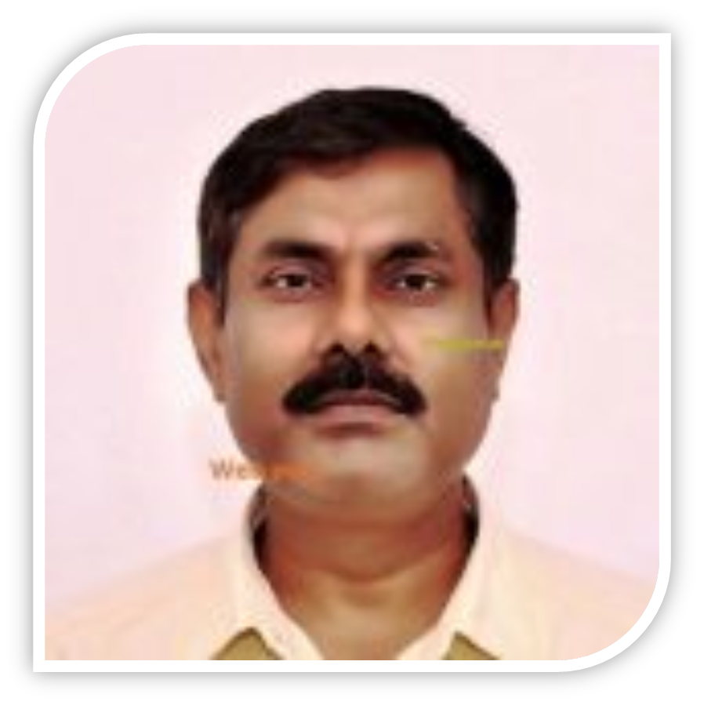
PATRON
PROF. RAJESH KUMAR
(DEAN, STUDENT WELFARE)

Slide 4
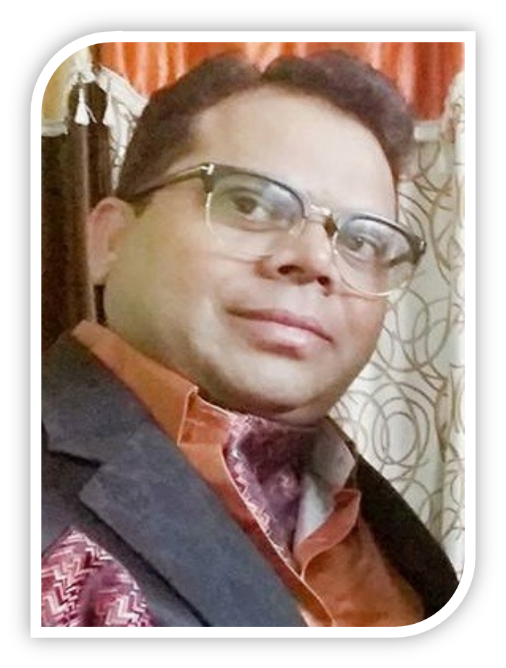
FOUNDER
Dr. ARVIND JAYANT
(PROFESSOR & HOD AT IGDTU)

Slide 5
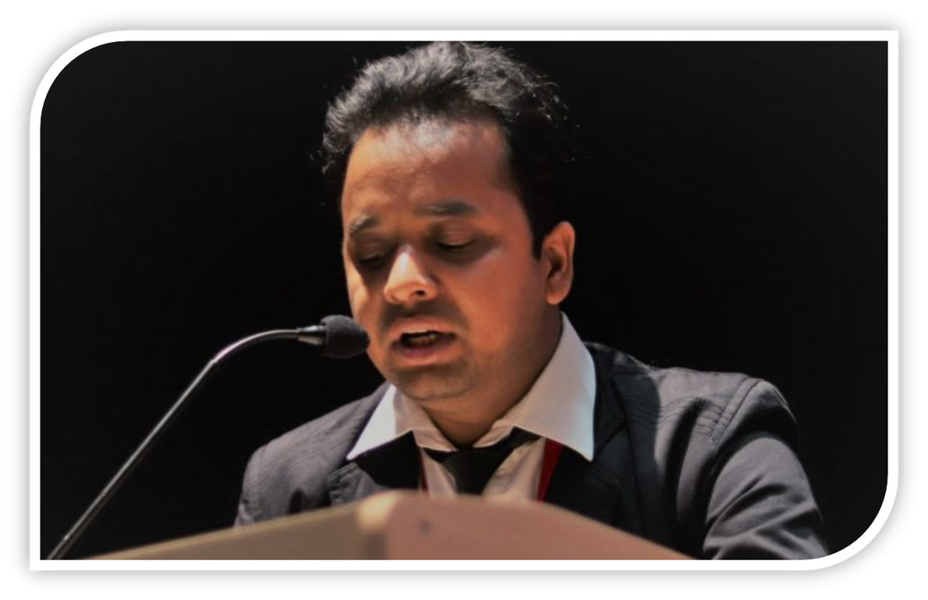
FOUNDER
Dr. KALEEM A. KHAN
(PhD, CURRENTLY RESIDING IN DUBAI)

Slide 6
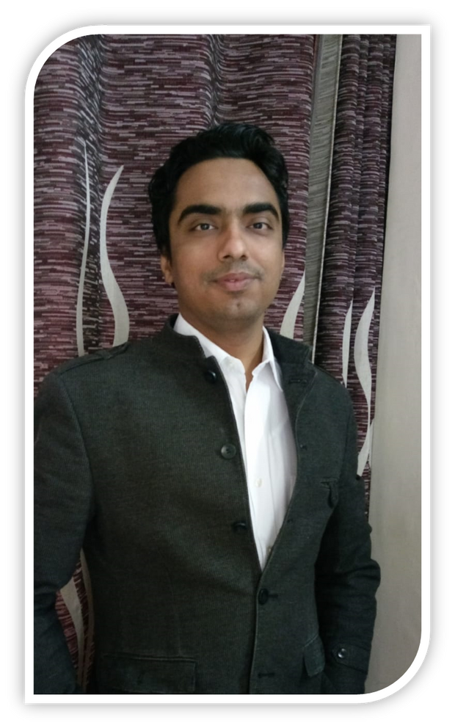
FACULTY ADVISOR
Dr. YOGESH KAPIL
(ASP, MATHEMATICS DEP. )

Slide 7


MEET
OUR
STUDENT ADVISOR

Slide 8
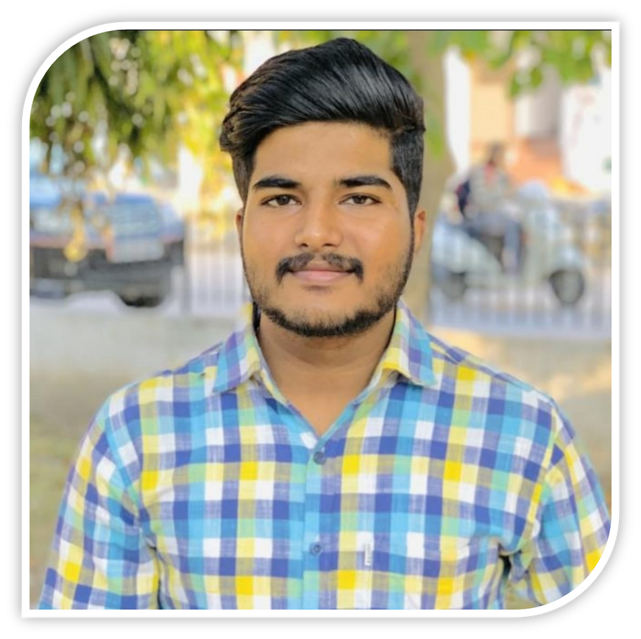
STUDENT ADVISOR
MR. MOHIT VERMA
(CURRENTLY WORKING IN INDIAN ACRYLICS LIMITED)

Slide 9
MEET
OUR
PRESIDENT

Slide 10
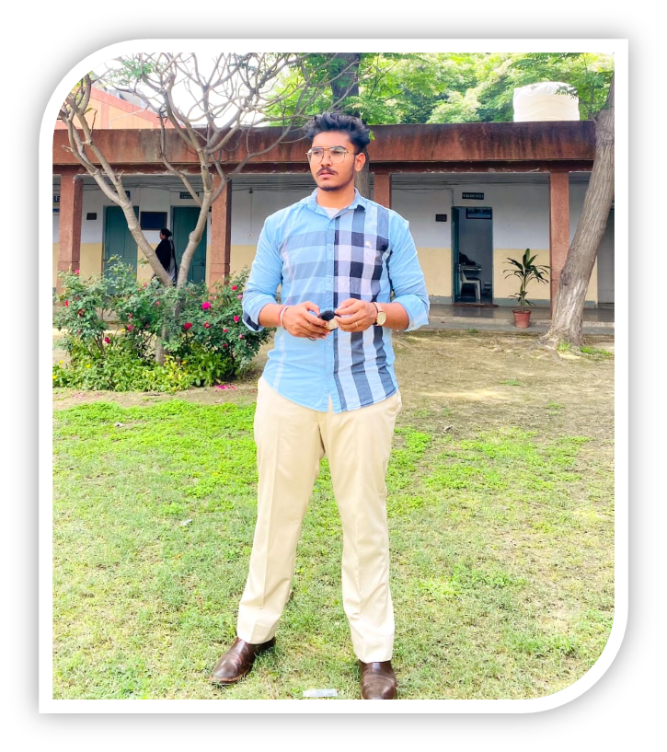
PRESIDENT
SUKHMANJOT SINGH

Slide 11
MEET OUR
VICE
PRESIDENTS

Slide 12
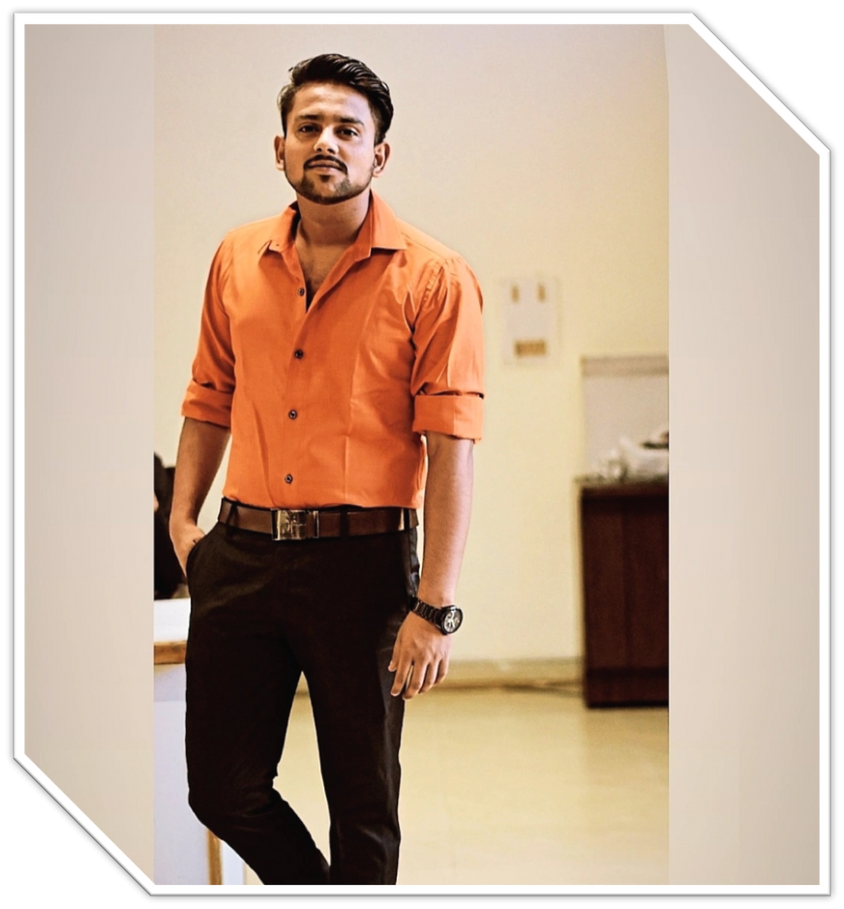
VICE PRESIDENT
RITIK KUMAR

Slide 13
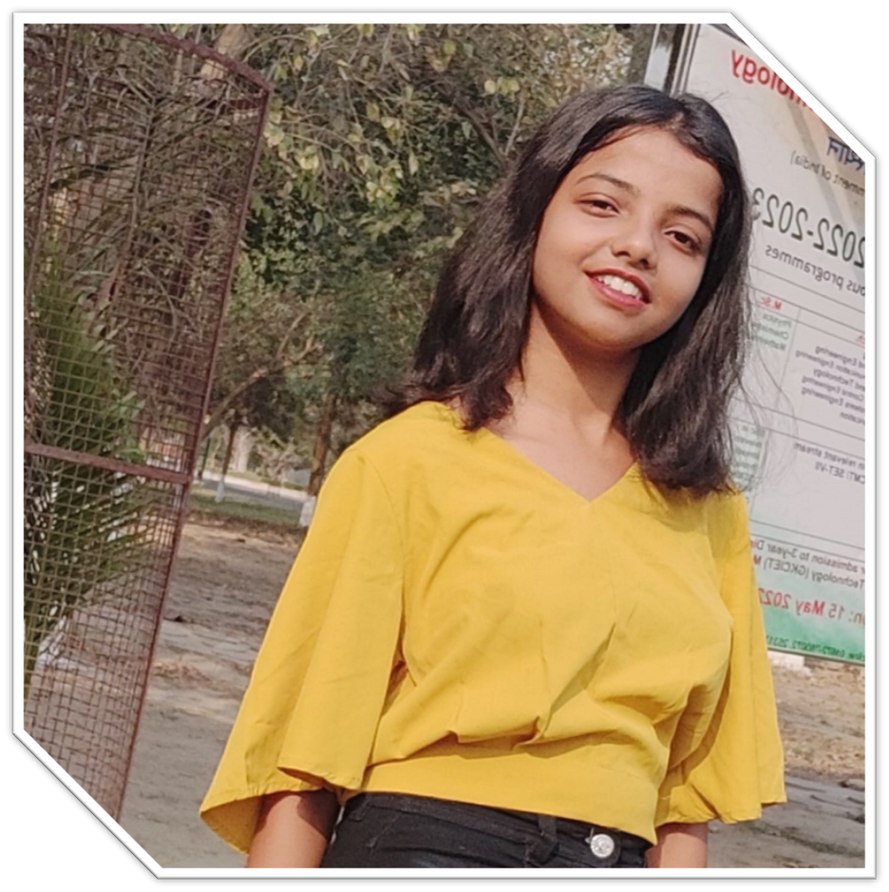
VICE PRESIDENT
TRIPTI SHARMA

Slide 14
OUR
COORDINATORS

Slide 15
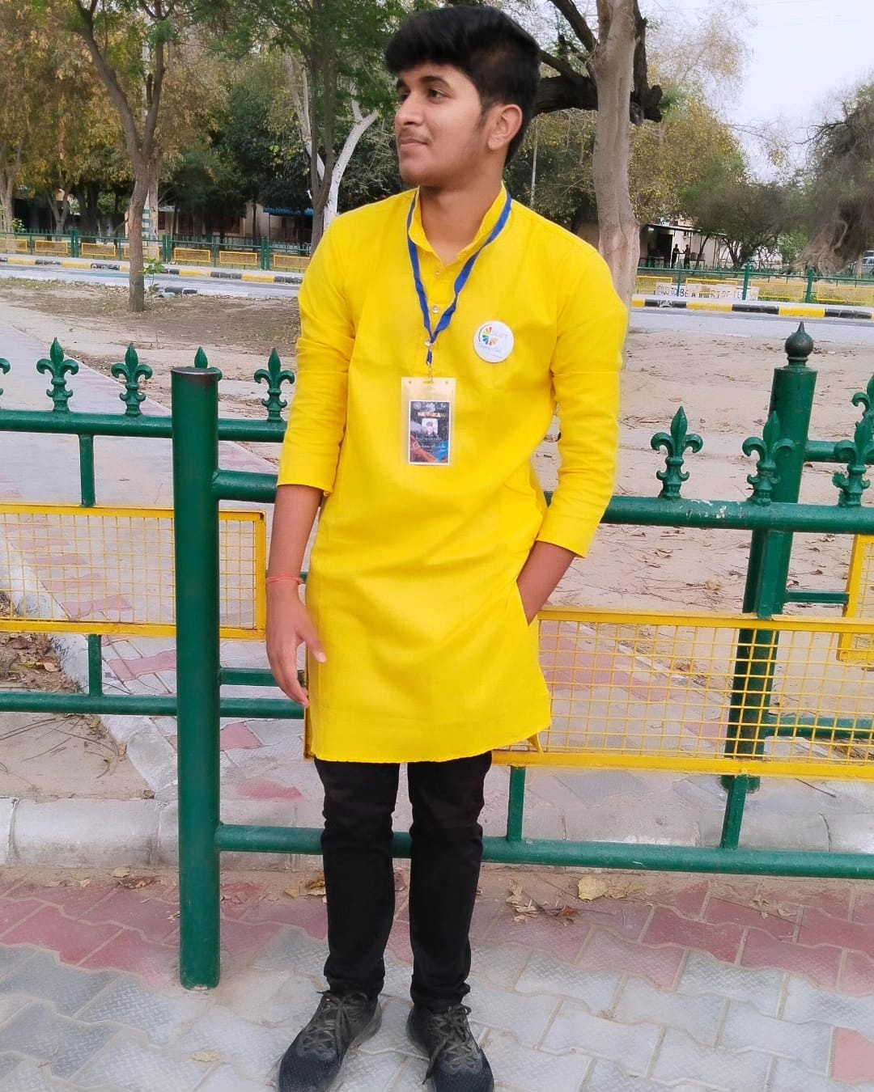
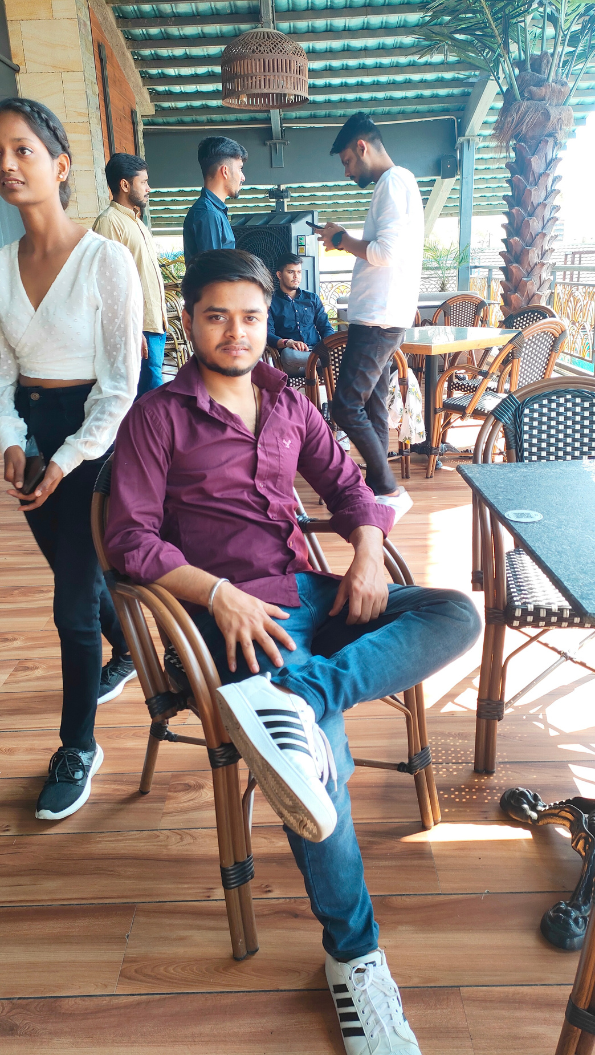
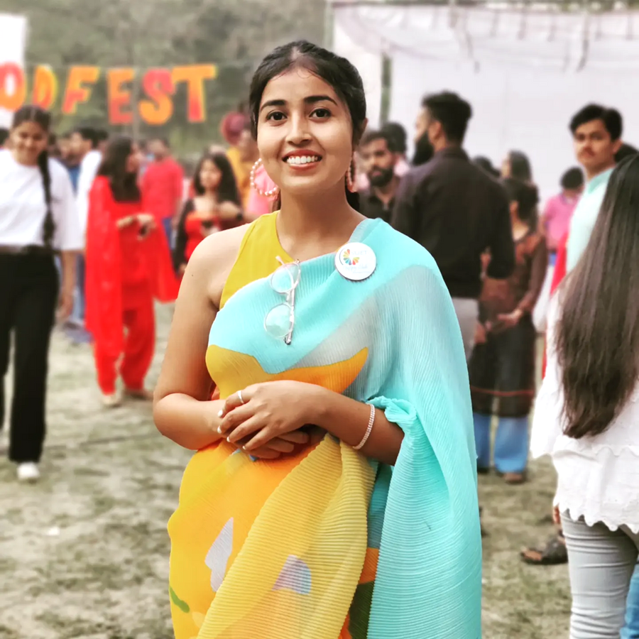
JAY WARDHAN
ABHISHEK KUMAR
ROHINI SINGH
Coordinator (Content Team)
Coordinator (Technical Team)
Coordinator (Koshish)

Slide 16
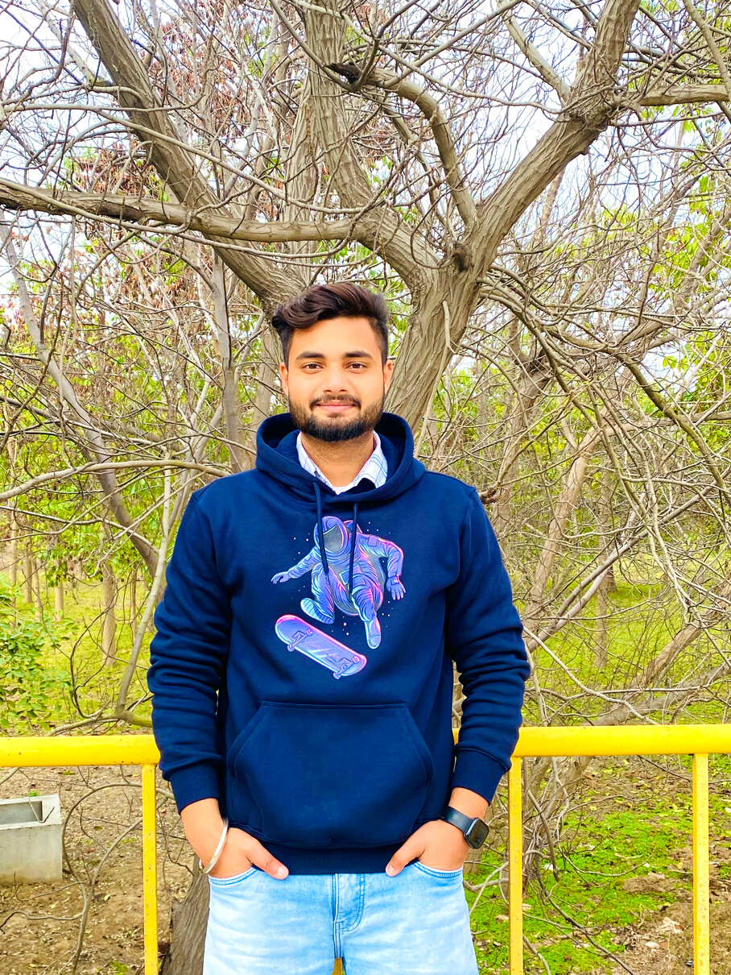
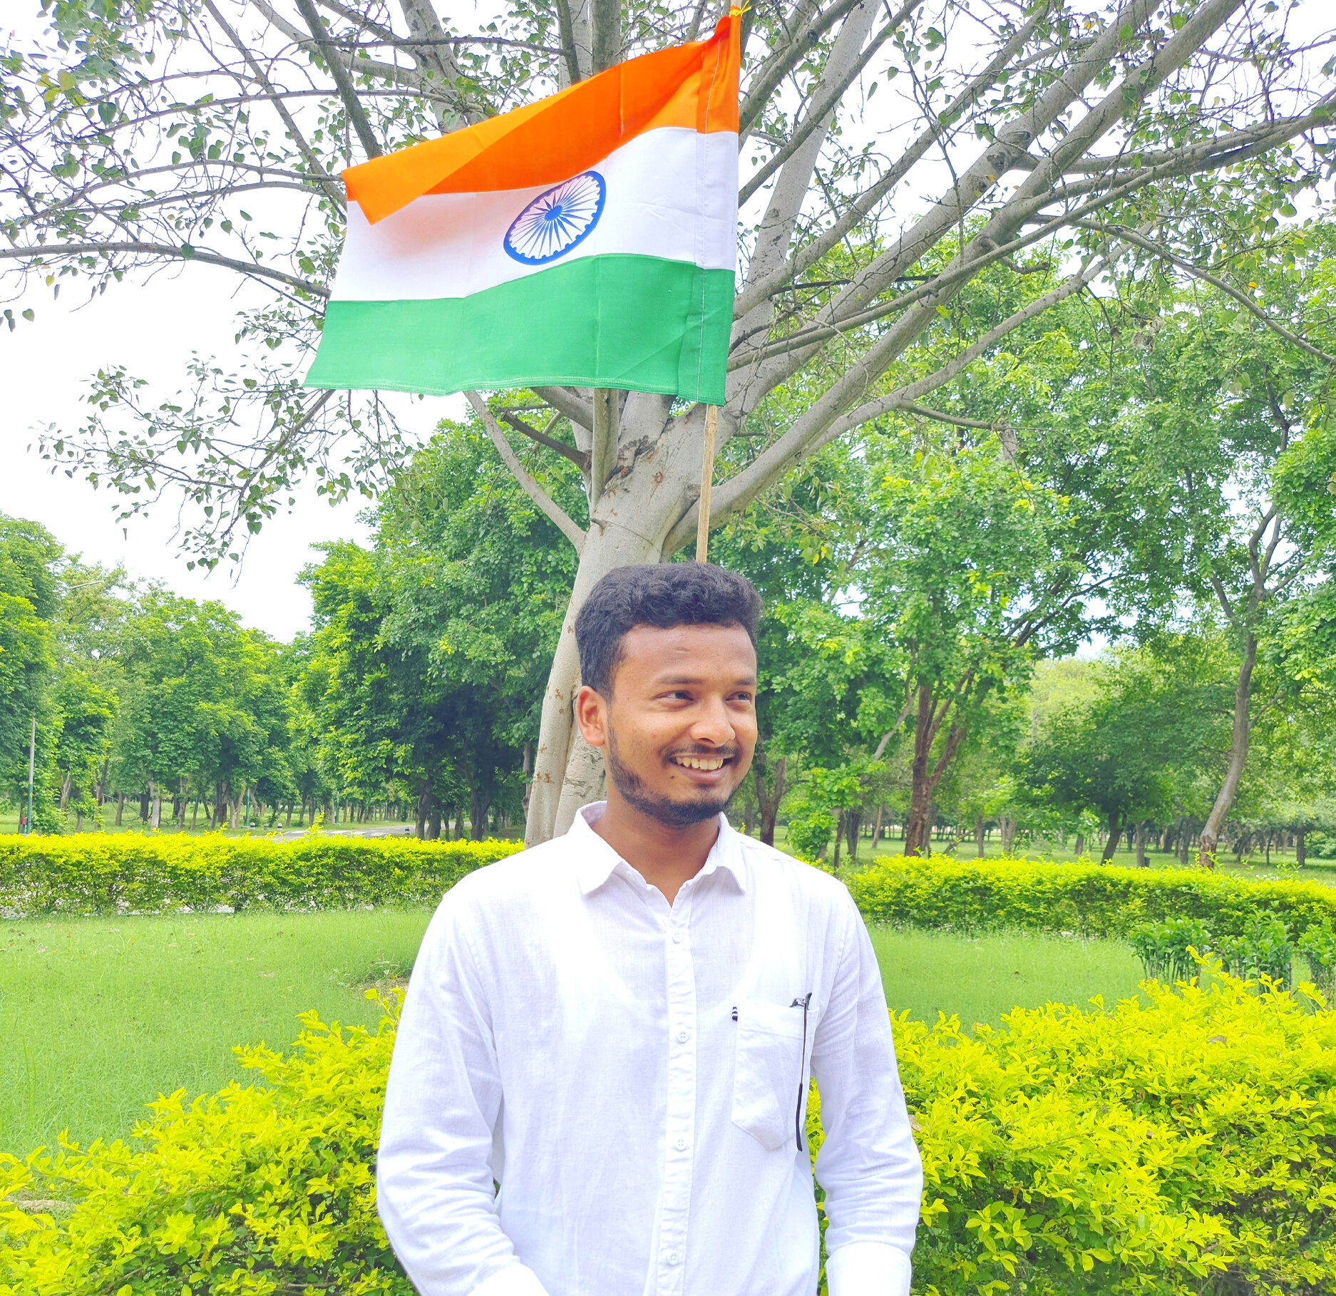
GOURAV KUMAR
AYUSH RAJ
Coordinator (Discipline Team)
Coordinator (Wall of Kindness)

Slide 17
OUR
CO-COORDINATORS

Slide 18

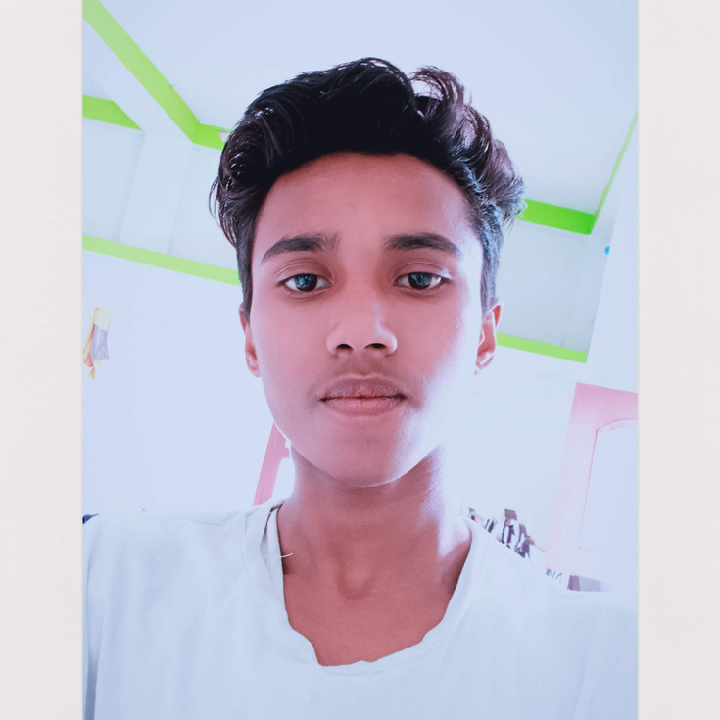
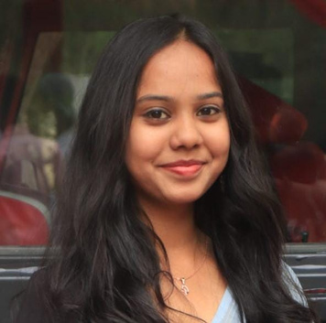
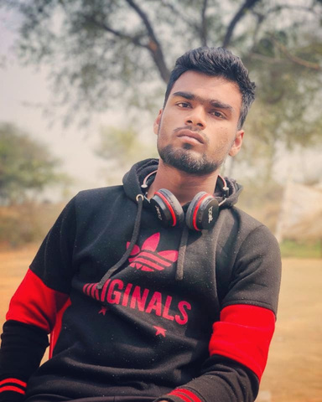
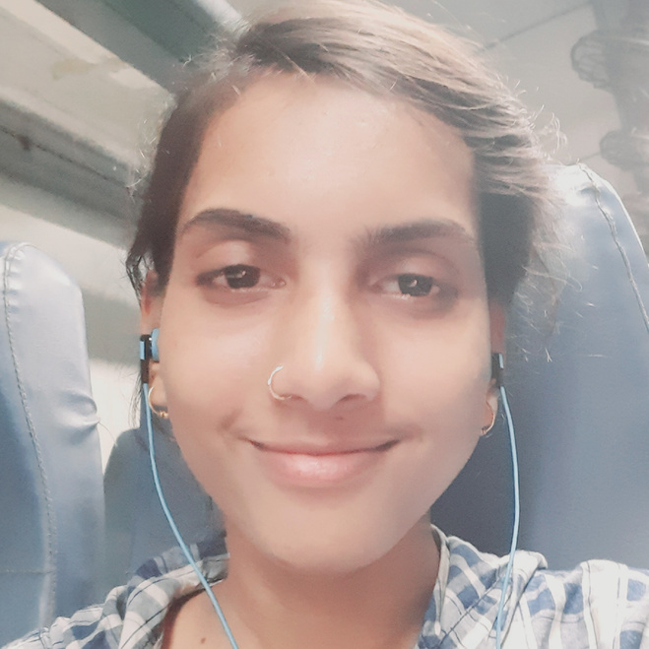
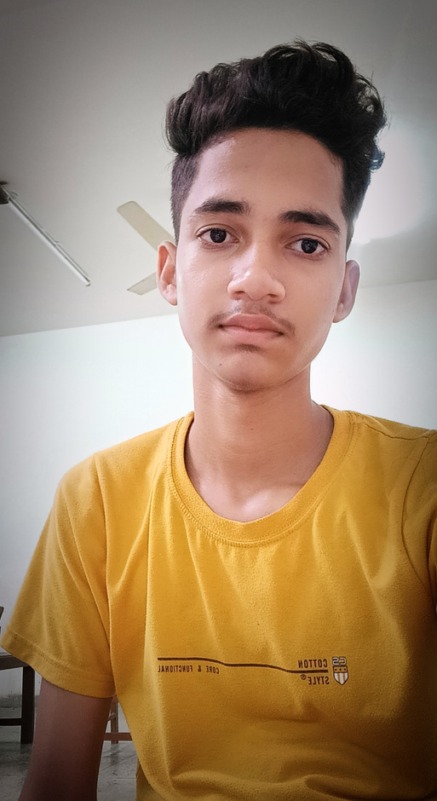
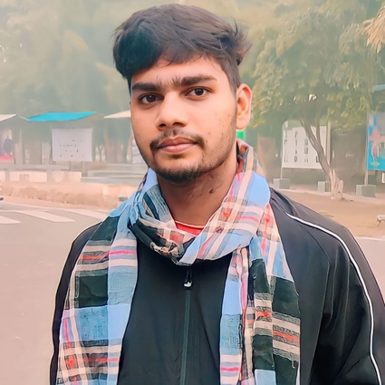
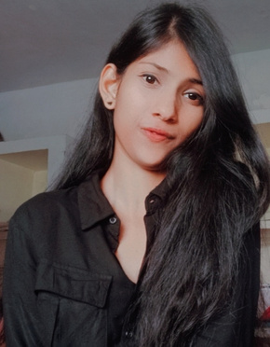
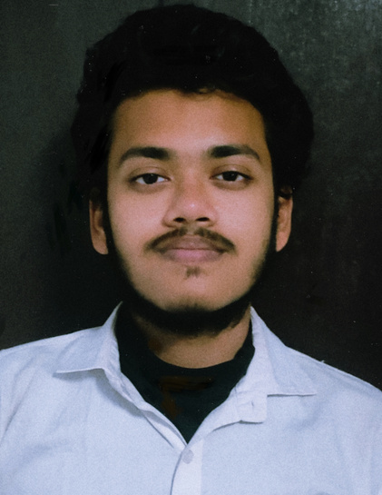
BIPANSHU KUMAR
NEHAL PRIYANI
AMIT RANJAN JHA
APARNA BHARTI
ADITYA RAUSHAN
VIKASH KUMAR
SHAKSHI SINGH
NAMAN KUMAR SINHA

Slide 19
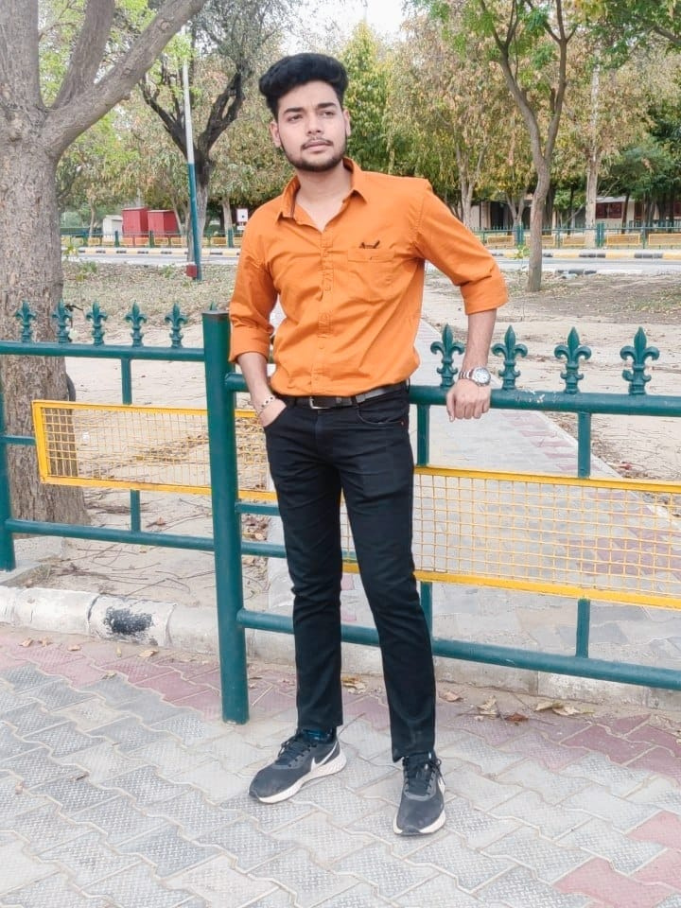

HIMANSHU CHAUDHARY
NAVJEET KAUR

Slide 20
OUR
EXECUTIVE MEMEBERS

Slide 21
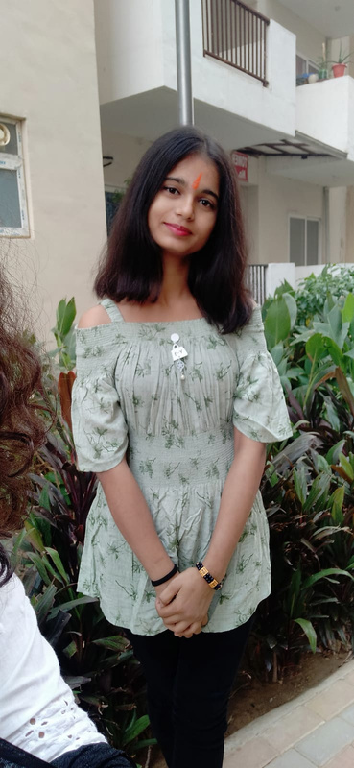
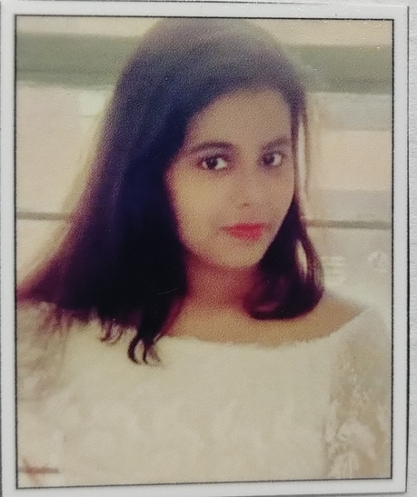
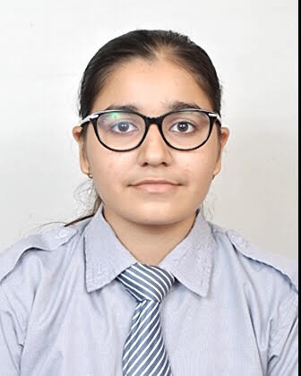
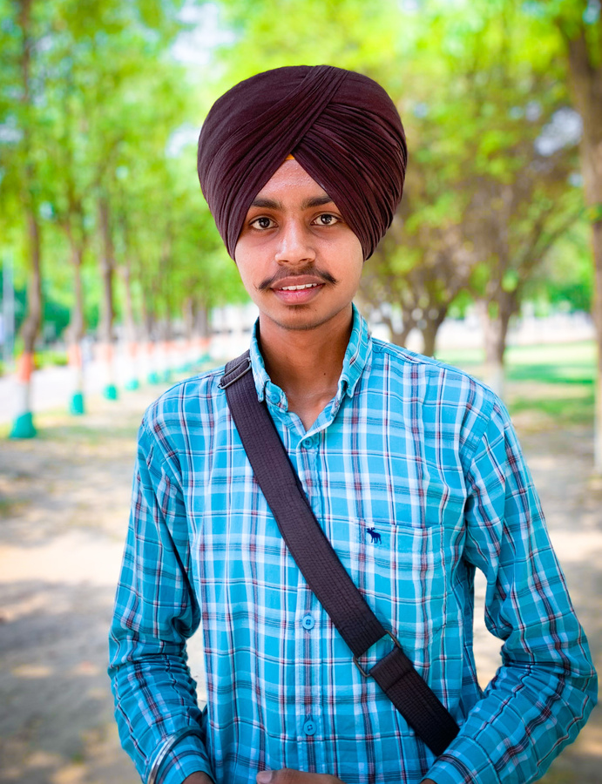
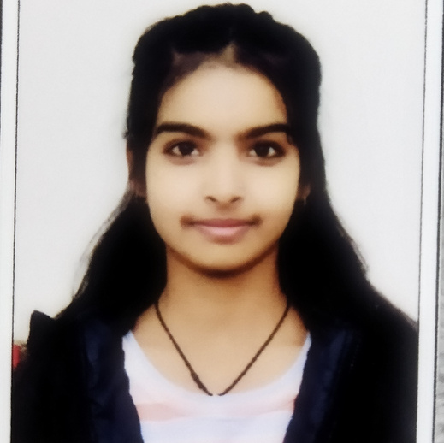
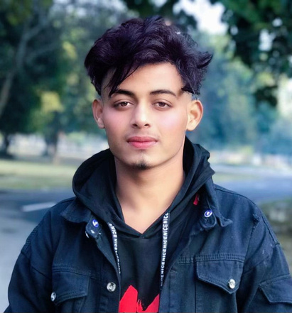
SUSHMITA PRITAM
JANVI KUMARI
SWATI DHIMAN
NAVPREET SINGH
NEHA KUMARI
ALFAZ KHAN

Slide 22

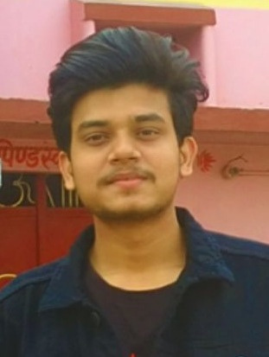
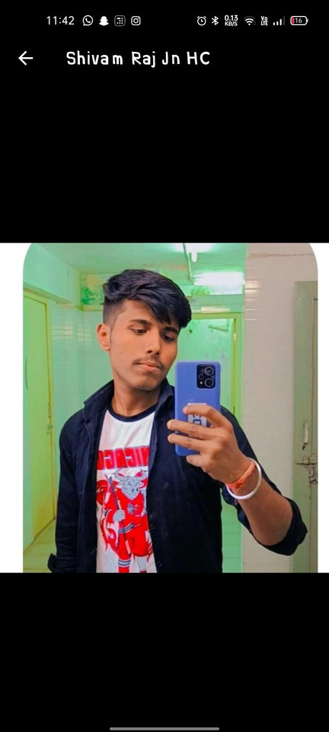
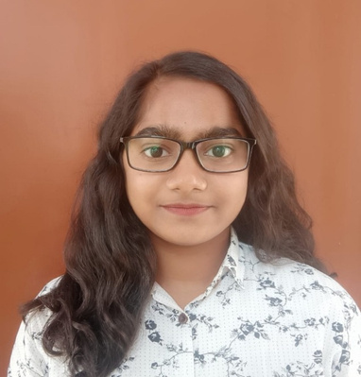
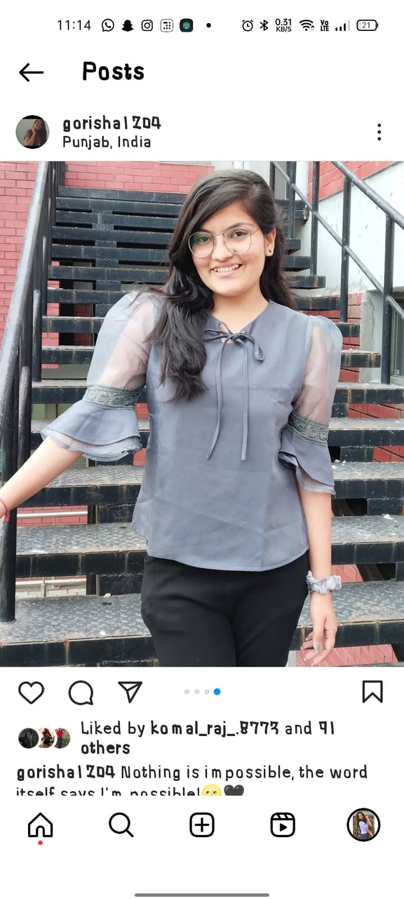
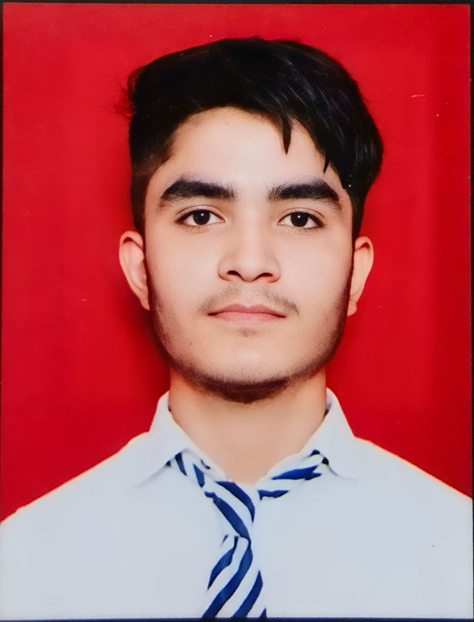
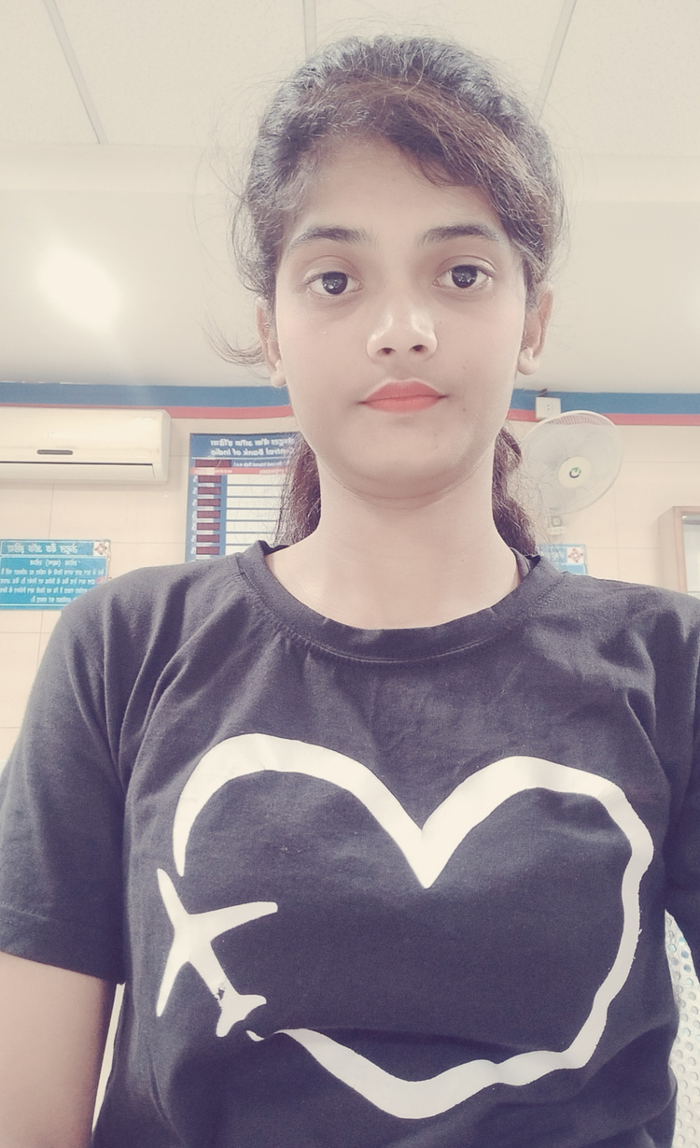
SHIVAM KUMAR
ASHUTOSH KUMAR
TWINKLE PODDAR
GORISHA SHARMA
KISHAN RAJ
RITIKA ANAND

Slide 23
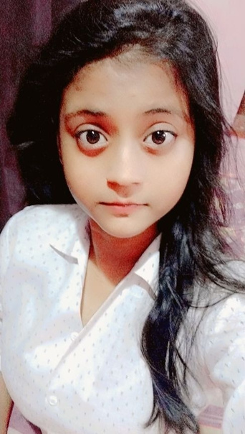
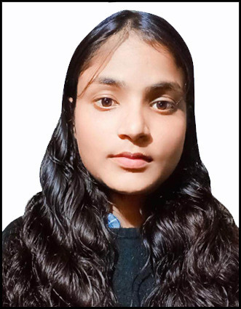
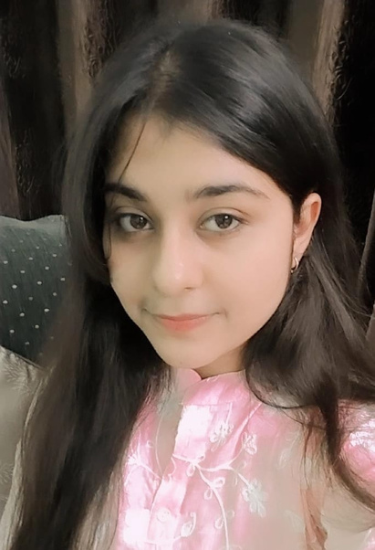
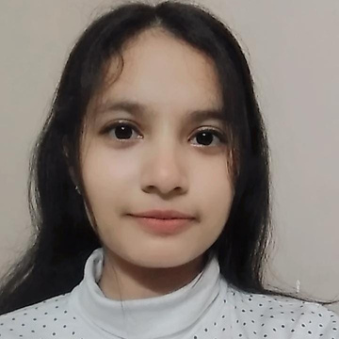
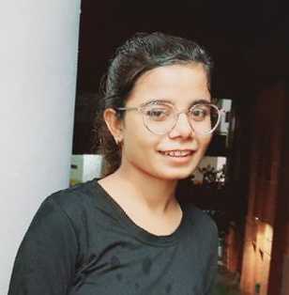
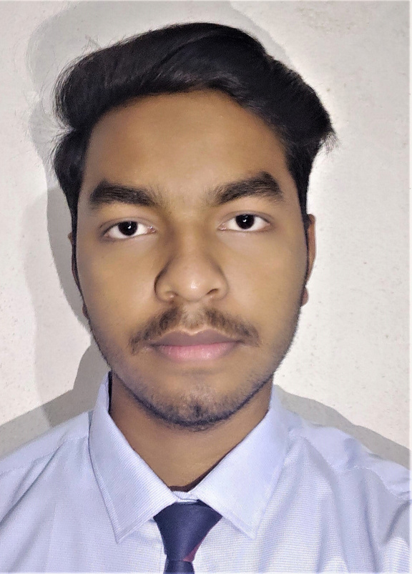
ANSHU KUMARI
AKANSHA SINGH
SARVAGYA
ADITI RAJ
KAJAL KUMARI
KUMAR SHANU

Slide 24
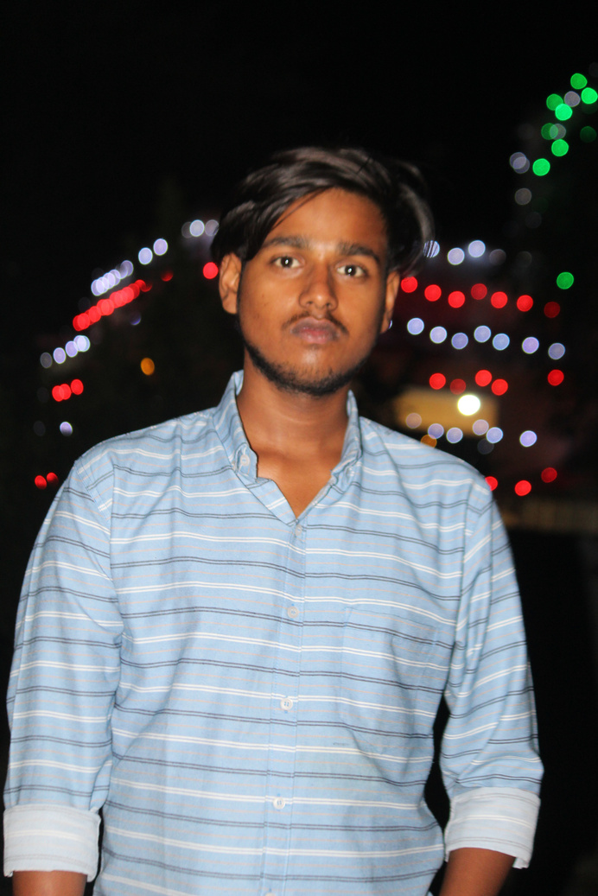
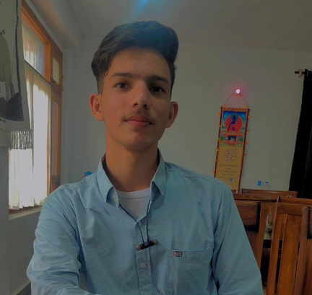
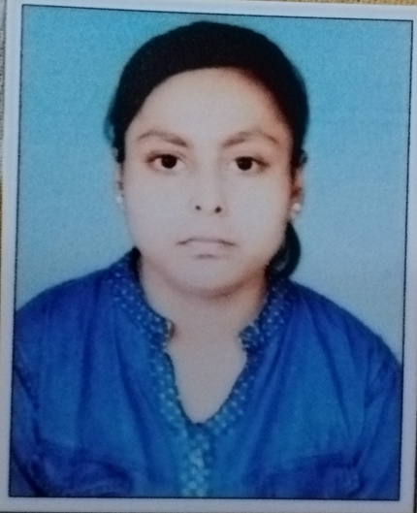
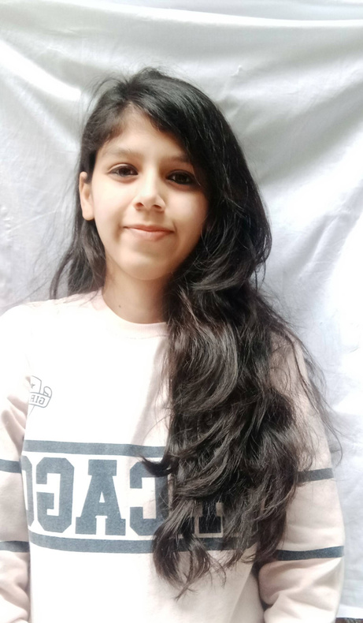
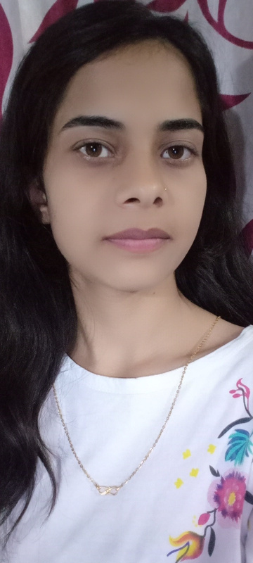
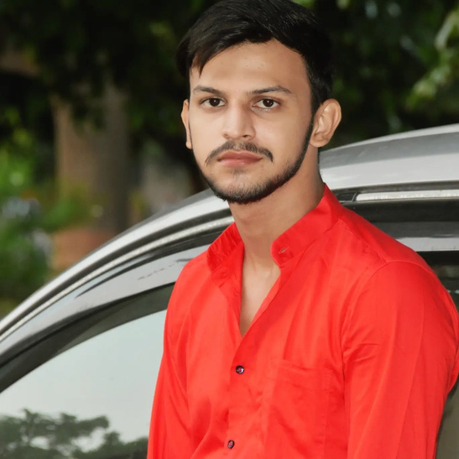
PRATEEK RANJAN
RAHUL SHARMA
RITIKA SINGH
SEJAL
YAMINI PRIYA
NISHANT SHUKLA

Slide 25
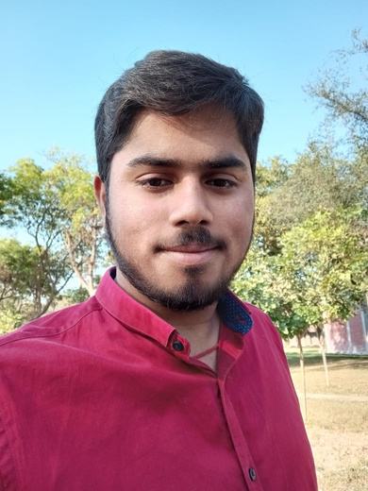
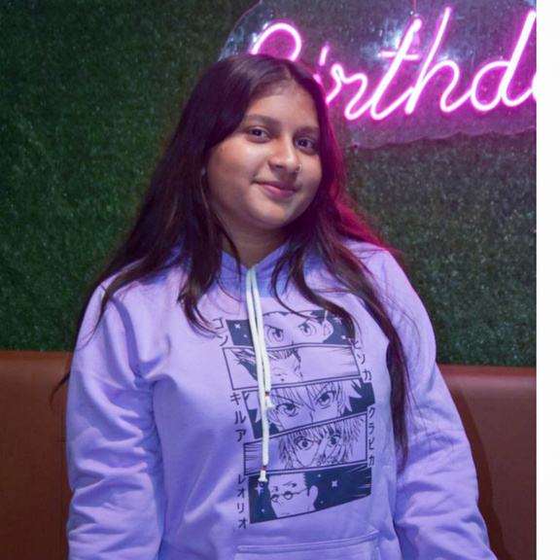
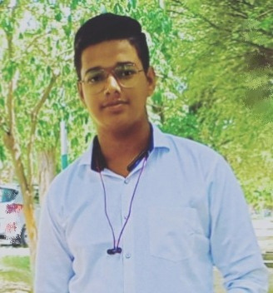



SHANTANU KASHYAP
SHIVANI GUPTA
RISHU KUMAR
MD SAYEED
CHANDAN RAJ
DIKSHIT KUMAR

Slide 26






ARYAN RAJ
ROHIT KUMAR
ARCHANA SINHA
KAVYANSHI
PRATISTHA RAJ
MINAKSHI SHRIVASTAVA

Slide 27






BADAL TIRKEY
RITIK KUMAR
HARSH RAJ
SOURAV KUMAR
ANAND KUMAR
VISHNU KUMAR

Slide 28




RISHIKA KUMARI
KRITI
RUDRANI KUMARI

Slide 29

THANK YOU
MADE BY :-
KRITI

